Slide 1

Case Study On: Optimizing Outreach Efforts for ACE Organization Authored By: Aditya Bhandari

Slide 2
Target Marketing -Fundraising
Goal: Develop a data mining model to improve the cost- effectiveness of the direct marketing campaign.
The organization, has its in-house database of over 1.82 million donors, According to their recent mailing records, the overall response rate is 5.1%. Out of those who responded (donated), the average donation is $13.33.
Using these facts, we will try to take a sample of this dataset to develop a classification model that can effectively capture donors so that the expected net profit is maximized. Weighted sampling is used, under-representing the non-responders so that the sample has a more balanced numbers of donors and non-donors.

Slide 3
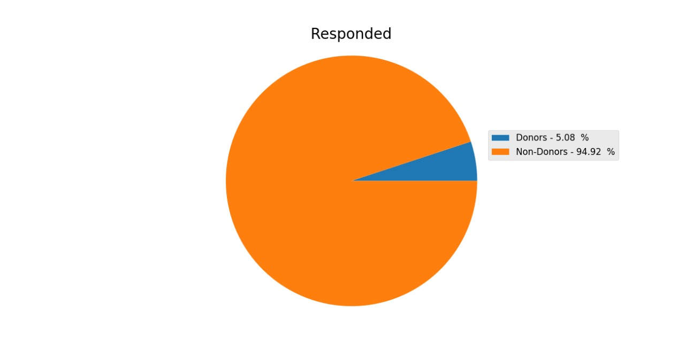

Slide 4
Data Cleaning
Our first step in cleaning the data was to make sure we understood all of the attributes available to us for analysis. We began by reading the attribute definitions and how they were measured using the variable description file.
We then categorized attributes that we thought would aid in model construction; identified those whose effect we weren’t sure of for PCA and eliminated the balance. Our categorization can be found in the tables in the APPENDIX. The attributes we kept focused mainly on factors of wealth and recent history of giving.
We found demographic attributes to be less important. Census data and government/military backgrounds were eliminated as well. Our logic is that someone who has the means to give is more likely to give than someone who doesn’t, irrespective of demographics. The demographic data also had a lot of holes in it, meaning we would have to make more assumptions than we were comfortable.

Slide 5
Significant Variable For Our Analysis
One of the most important variable is INCOME as it helps us in determining the donating capability of individuals. A person with high income might be willing to donate than a person with a low income.
AGE would also be helpful for us to know which age group to target. Like people with age more than 30 are more likely to donate as compared to teenagers who are less likely to donate .

Slide 6
Exploring further, we observe that donors’ vs non donors are evenly distributed among the age ranges. Since there are almost no donors below the age of 25, so no solicitation should be sent to this group. Most of the people who make donation are above the age of 25 therefore we have to send them solicitation.
Variable | Min | Max | Mean | Std. Deviation
AGE | 2 | 98 | 61.652 | 16.390
INCOME | 1 | 7 | 3.920 | 1.859
WEALTH1 | 0 | 9 | 5.396 | 2.746
LASTGIFT | 0 | 450 | 16.765 | 12.771
AVGGIFT | 2.261 | 450 | 13.038 | 10.398

Slide 7
Key Observations From the Previous Table
AVGGIFT – Average Gift is the amount of donation which we can expect from potential donors.
Offers should be sent to people with high income that is people with income greater than the mean income.
The average INCOME of the group is 3.920
The histogram above shows that major donors are people of age between 40 and 80. AGE lies between 2 and 98.
There are a total of 480 attributes provided to us. A lot of these variables are not useful to us and also quite a few of them have missing values. Hence we clean the data and also normalize as required. On the new dataset we apply the models.

Slide 8
Elimination of Useless variables
The following 167 variables were eliminated as they weren’t as useful as the others in guessing donor and non-donors.
Attributes | Reason for removal
ADATE_2 - ADATE_24 | Date of previous promotions are of no significance. Here the exercise is to predict the right donor.
ANC1 - ANC15 | Ancestry of persons is of no significance in predicting donors and non-donors.
(CHIL1 - CHIL3), (CHILC1-CHILC5) | These defines age of children and are of no use. In the age distribution chart we examined that no significant donors are below age 25.
ETHC1 - ETHC6 | Ethnicity of persons is of no significance in predicting donors and non-donors.
HC1-HC21 | Information regarding residence makes no sense in predicting donors and non-donors.
HPHONE_D | Phone Number is of no significance in predicting donors and non-donors.
ODATEDW, OSOURCE, TCODE, DOB, NOEXCH, AGEFLAG, DATASOURCE, GEOCODE, LIFESRC | These are donor's basic information which may not be helpful in predicting his future actions.
MDMAUD, (OEDC1 - OEDC7), (EC1 - EC8), (RFA_2 - RFA_24), MDMAUD_R, MDMAUD_F, MDMAUD_A, (RDATE_3 - RDATE_24), (RAMNT_3 - RAMNT_24), TIMELAG, RFA_2R, RFA_2F, RFA_2A, (AGE901- AGE907), RAMNTALL, CLUSTER,CLUSTER2,GEOCODE | No help in performance improvement of the model by these variables.
WEALTH2 | Considering WEALTH1 instead of this variable.
LSC1 - LSC4 | Language of persons is of no significance in predicting donors and non-donors.

Slide 9
Transformations and Missing values
Missing values like “?” are replaced and mapped to N.
This is done using transformations where if value exist 1 is replaced and for no values 0 is replaced.
After the new attribute is created we need to delete the old attributes in order to avoid redundancy.

Slide 10
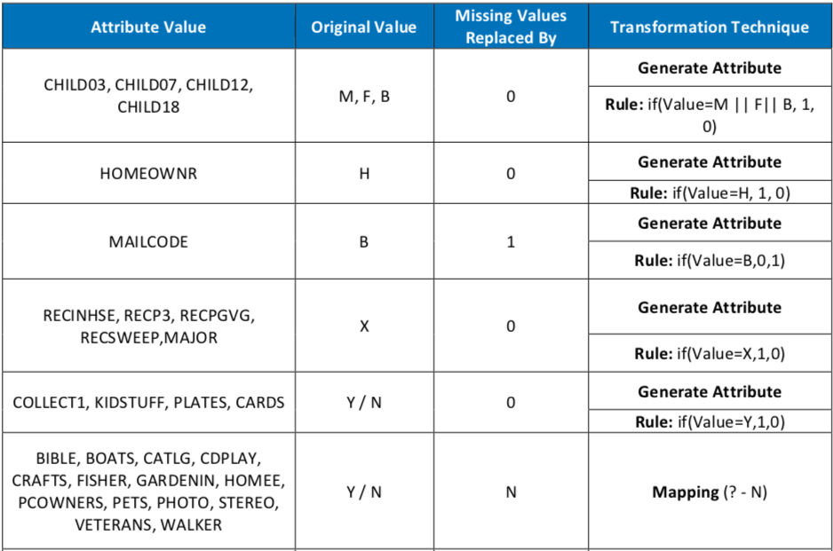
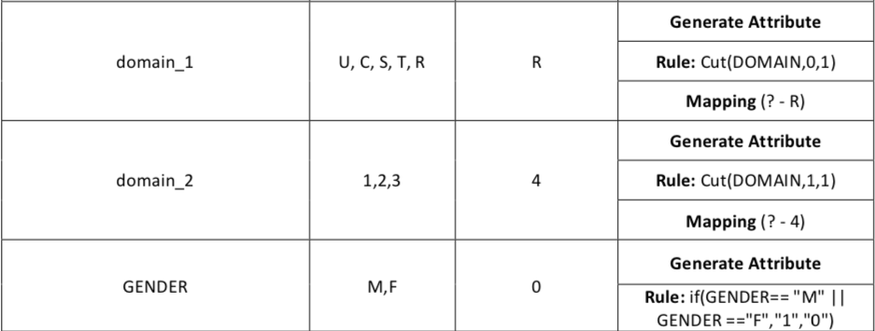

Slide 11
Feature Selection/Dimensionality Reduction Using Principal Component Analysis(PCA)
We are still left with around 312 variables after elimination, transformations and mapping of missing values on the variables we require for analysis. The number of attributes on which we perform predictive analysis to determine the response when we make offer is still large. This makes it complex to consider such a large number against just one response attribute market. Hence we perform PCA on 271 variables.
We divide the attributes in 3 categories for the PCA namely
PCA1- Donor’s interests and hobbies
PCA2- Donor’s giving abilities
PCA3- Donor’s neighborhood

Slide 12
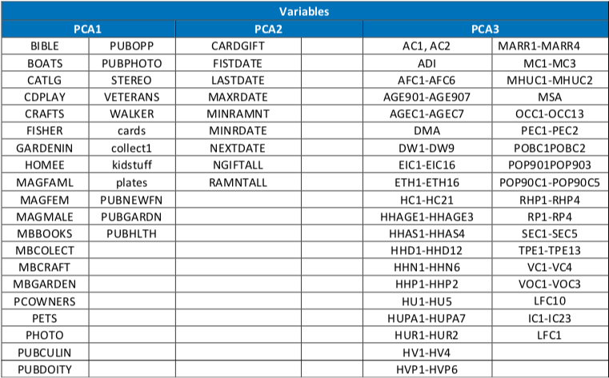

Slide 13
Application of Principal Component Analysis
Applied PCA on the PCA1 set of attributes which contain information about interests and hobbies of donors. However not all of these attributes are necessary in prediction of donation from donor therefore we perform PCA on these attributes and get cumulative effect of number of attributes reduced to few reduced attributes.
Performed PCA on the PCA2 set of attributes which contain information about the different aspects of donations made by the donors in the past.
The PCA3 set of attributes contains 230 attributes and its time consuming to measure the effect of these attributes on the response variable. Hence PCA is performed and we reduce the number for attributes by using FIXED NUMBER OF COMPONENTS.
Finally we are able to reduce these 271 variables in 96 variables after PCA.

Slide 14
Scope For Classification
The dataset is divided into 60:40 split (60% for training and 40% for validation). Also for the VALIDATION, the random seed was set to 1234.
After elimination of useless variables, transformations, mapping and PCA on selected attributes we have a reduced set of attributes on which we apply different modelling techniques
We can even use Decision Trees, Random Forests, and Naïve Bayes in determining which of the remaining 41 attributes should be included in the predictive model for donors.
I also believe Logistic Regression, SVM’s, or Neural Nets can be applied for better classification accuracies. But here we will only try to stick to one
Few of the key attributes that will be use in final modelling are:
GENDER
INCOME
Numchild
Major
Mailcode
Child3, child7, child12, child18
Also the marketing cost for different zipcode can be joined with zip column in train and test dataset for calculating the profitability of our campaign. Which will be helpful in calculating the probability of whether a person will donate or not.

Slide 15
Scope For Classification
Due to time constraint we were not able to cover classification and performance comparison for different data mining models
The 5 different iterations on which we can perform predictive analysis are
Testing performance of base variables only
Testing performance of base variables along with PCA
Testing performance when PCA1 subset is not considered.
Testing performance when PCA2 subset is not considered.
Testing performance when PCA3 subset is not considered.

Slide 16
Scope For Classification- Logistic Regression
Although, I believe Logistic regression is the appropriate regression analysis to conduct when the dependent variable is categorical. Like all regression analyses, the logistic regression is a predictive analysis. Logistic regression is used to describe data and to explain the relationship between one dependent variable and one or more independent variables by estimating probabilities using logistic function.

Slide 17
Scope For Classification - Tree Methods
To evaluate the expected values of conflicting options we use decision trees. Decision tress are used as graphical and analytical decision support tool. In our analysis we use the following parameters
U-Unpruned tree parameter
L - Do not clean up after the tree has been built
A – Laplace Smoothing for predicted probabilities
Random Forests: are methods for classification and regression that run on constructing a congregation of decision trees at the training time and outputting the class that is the node of the classes or mean prediction of individual trees.
The general idea in Boosted Trees is to compute a sequence of simple trees, where each successive tree is built for the prediction residuals of the preceding tree. The algorithm for Boosting Trees evolved from the application of boosting methods to regression trees. Over the past few years, this technique has emerged as one of the most powerful methods for predictive data mining.

Slide 18
Scope For Classification – Naïve Bayes
Naive Bayes methods are a set of supervised learning algorithms based on applying Bayes’ theorem with the “naive” assumption of independence between every pair of features.
We can perform Naïve Bayes model on the 5 iterations with the following parameters
Laplace correction

Slide 19
Thank You

